Slide 1
Arrays in Java
Week 5

Slide 2
Agenda
Recap of Last Lecture
Arrays
One-D Arrays
Two-D Arrays
Recap of the Lecture

Slide 3
Arrays
Collection of homogenous datatypes
Array Declaration
  type varName [] = new int [12] ;
  int monthDays [] = new int [12] ;
Array initialization
  varName [index] = value ;
  monthDays [0] = 31 ;
Array index
  Uniquely identify array element and always start with 0.

Slide 4
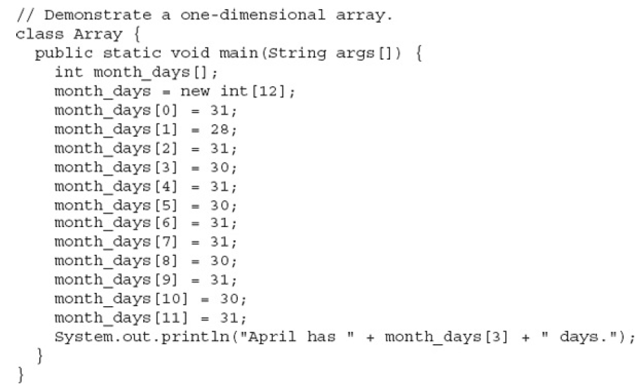
Arrays

Slide 5
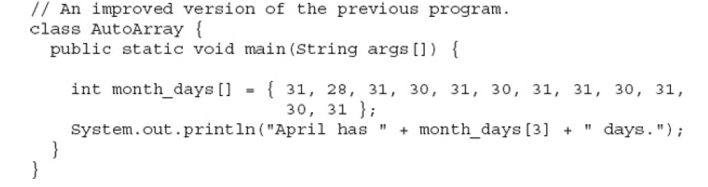
Arrays

Slide 6
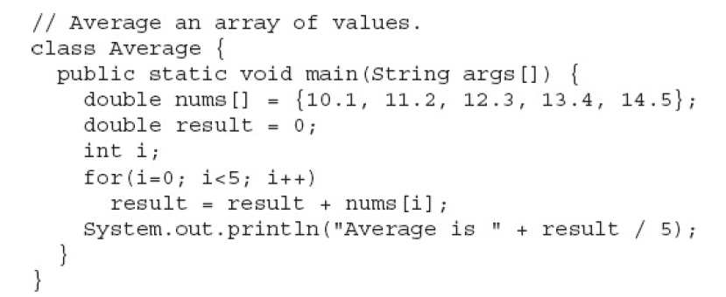
Arrays

Slide 7
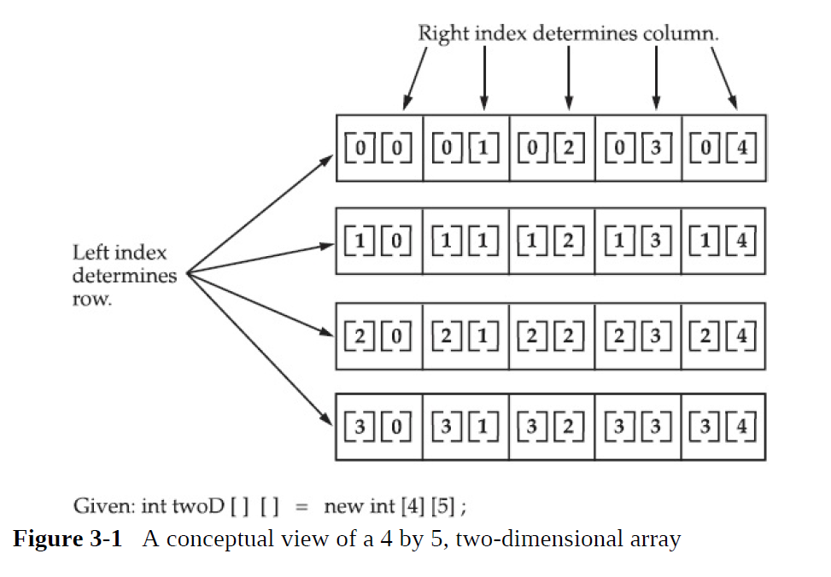
Multi-Dimensional Arrays

Slide 8
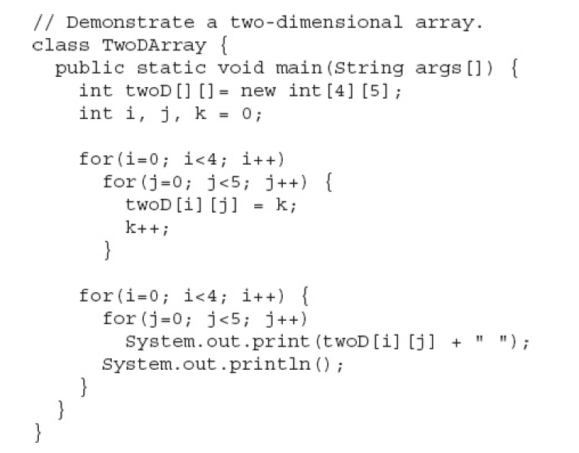
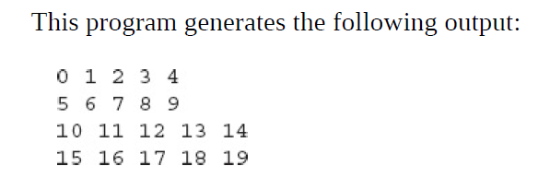
Multi-Dimensional Arrays

Slide 9
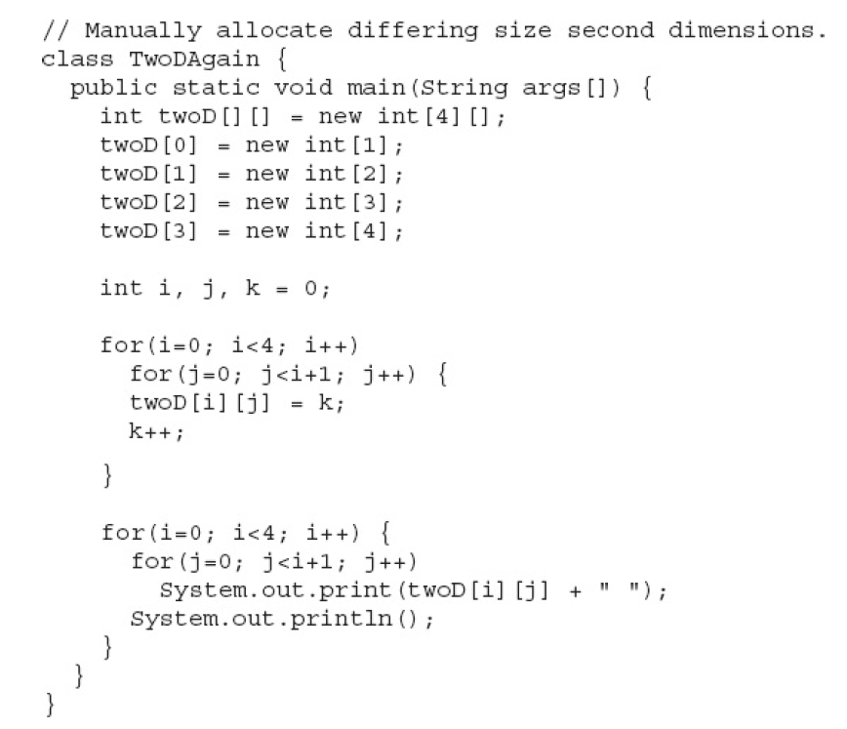
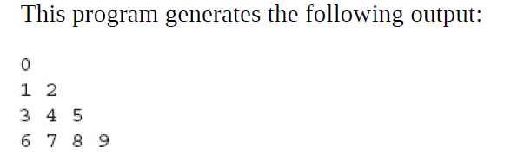
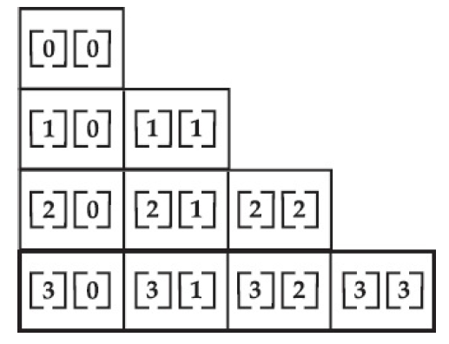
Multi-Dimensional Arrays

Slide 10


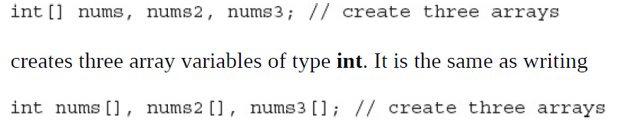
Alternative Declaration of Array

Slide 11
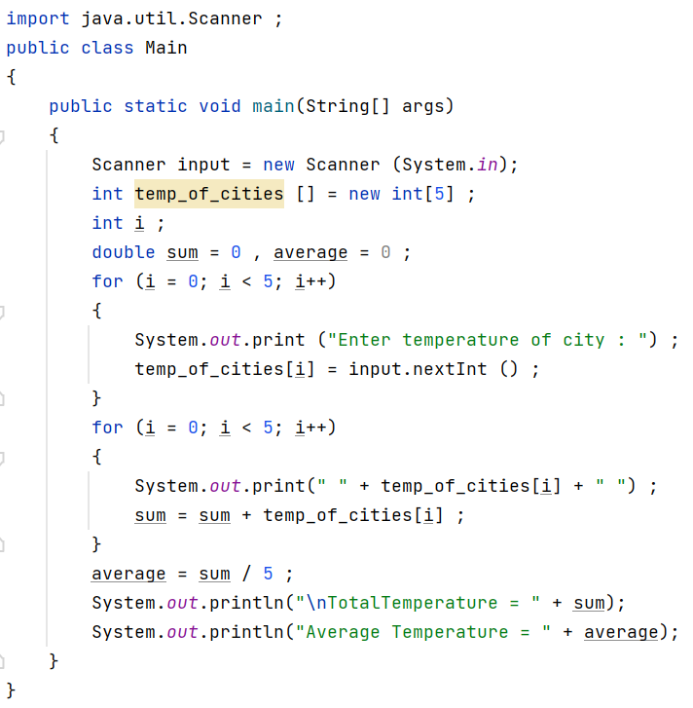
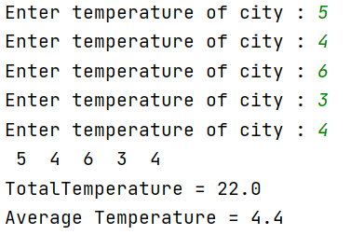

Slide 12
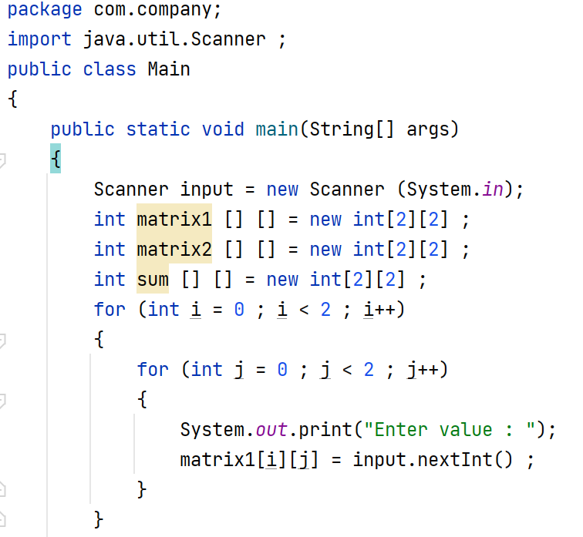

Slide 13
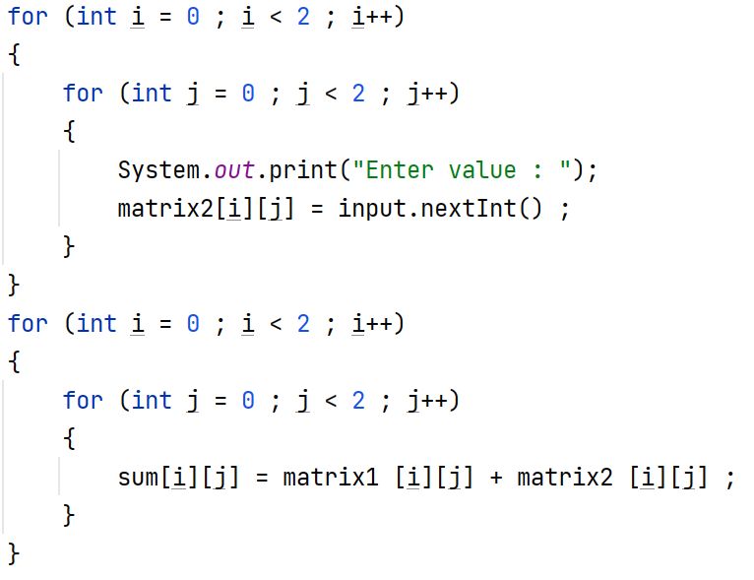

Slide 14
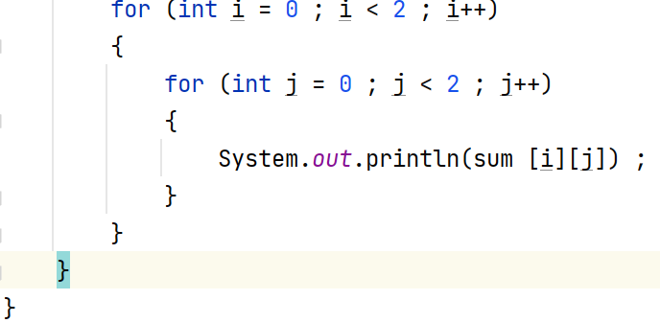

Slide 15
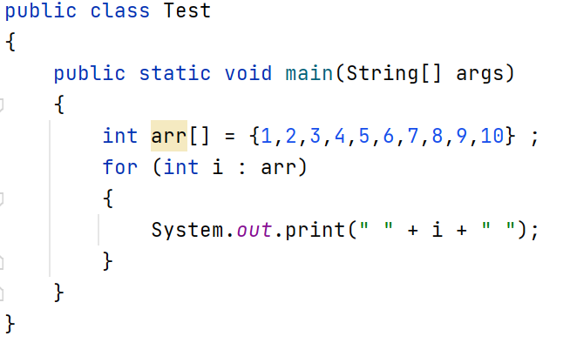

For Each Loop

Slide 16
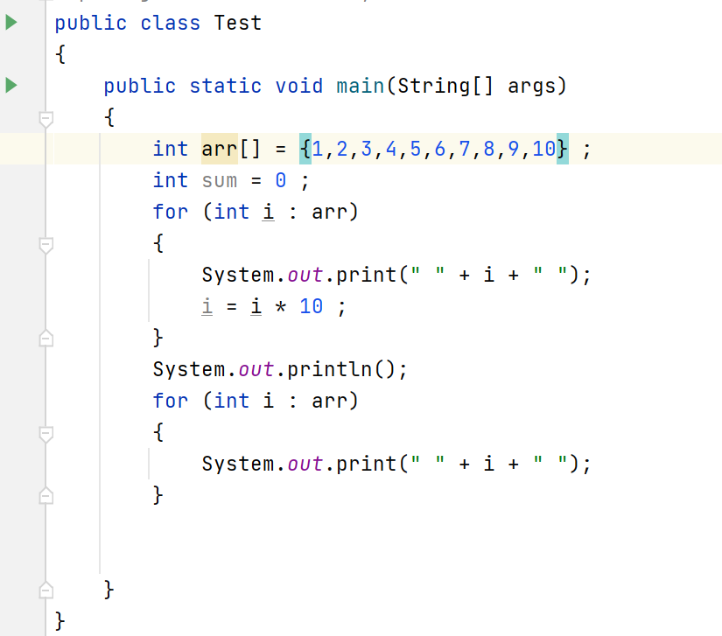
For Each Loop is Read Only Loop

Slide 17
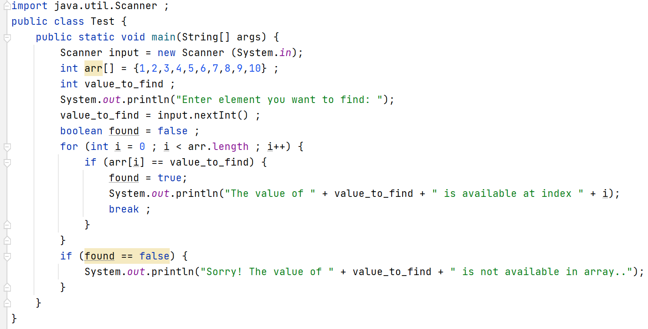
Linear Search Program

Slide 18
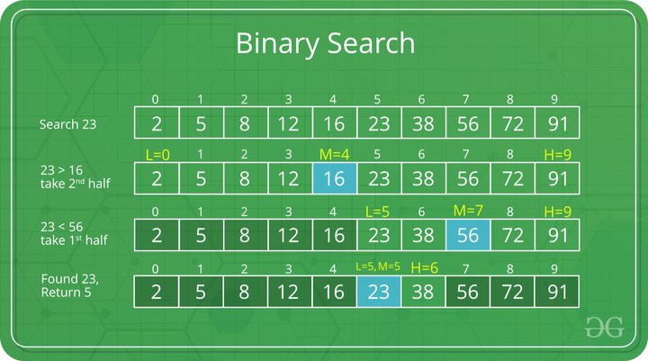

Slide 19
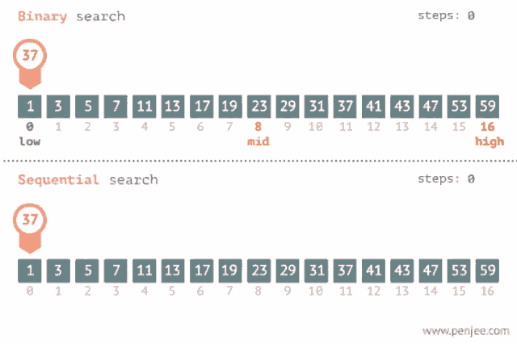
https://tenor.com/view/binary-search-sequence-search-gif-20595028

Slide 20
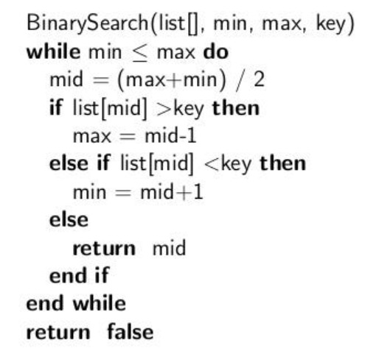
Binary Search Pseudo code

Slide 21
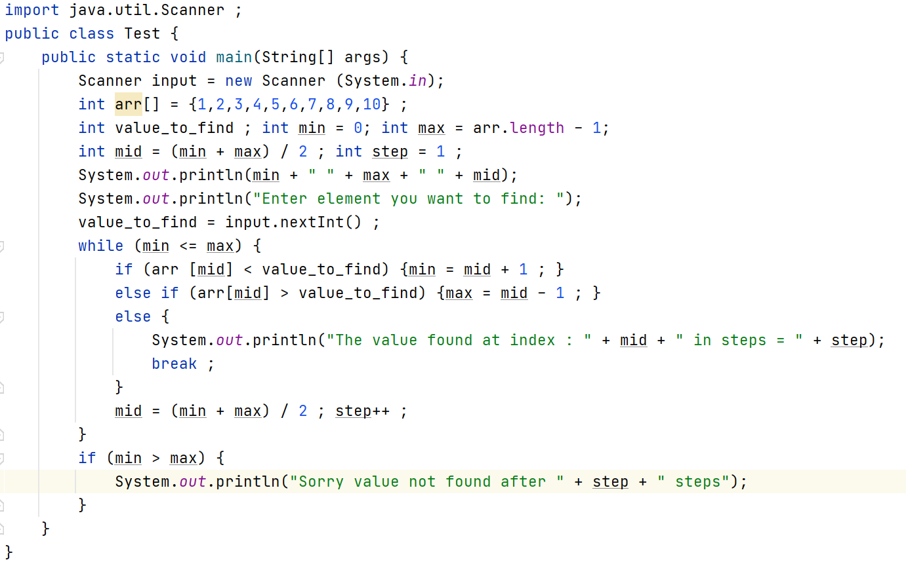
Binary Search Program

Slide 22
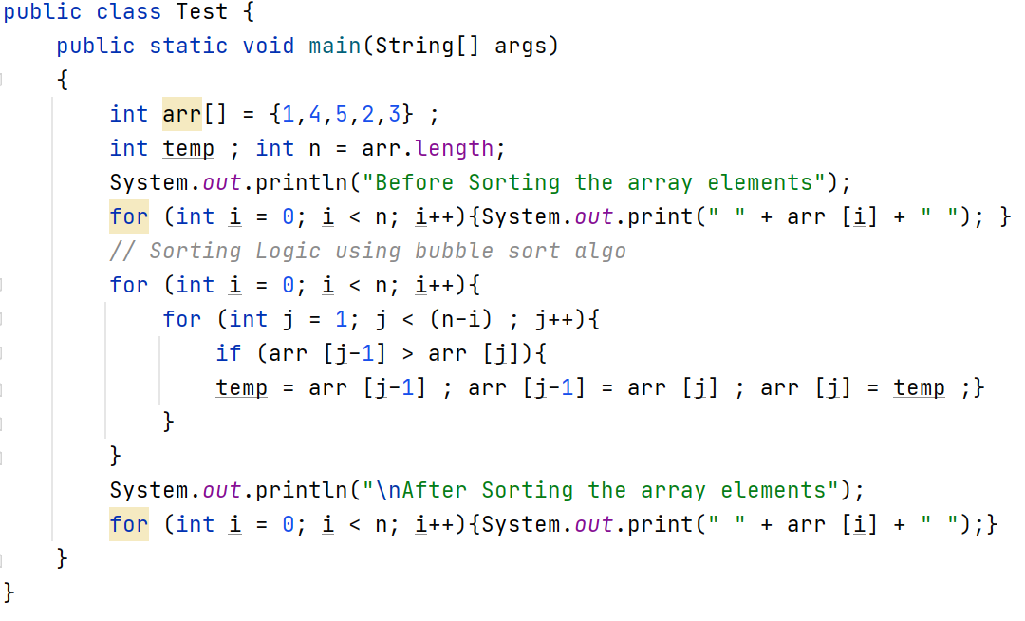
Bubble Sort Algorithms
https://www.hackerearth.com/practice/algorithms/sorting/bubble-sort/visualize/
https://yongdanielliang.github.io/animation/web/BubbleSortNew.html

Slide 23
Recap
Arrays
One-D Arrays
Two-D Arrays

